Slide 1
Human Computer Interaction
Presentation of Coronavirus application
Group Members
Paul, Djourdan, Ndivhuwo, Pietro, Florijn

Slide 2
Our Application
VR Android
Virtual world in a realistic environment
Character aims to adhere to social distancing regulations
Increase compliance with coronavirus restrictions

Slide 3
1. Objective of the game

Slide 4
Objective of the game
Get through all the locations of the game without getting infected
Done by wearing a mask, sanitize the hands and keeping the safety distance from the bots in the game

Slide 5
2. Interactions
Paul, Djourdan, Ndivhuwo, Pietro, Florijn

Slide 6
Interactions
In this game you interact with different objects.
Example of objects with interaction are mask, sanitizer and other bots.

Slide 7
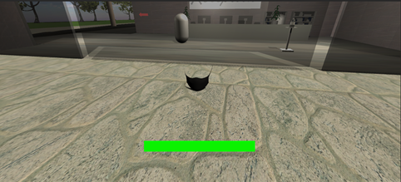
Mask

Slide 8
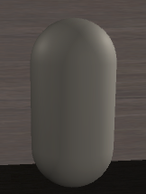
Bots

Slide 9
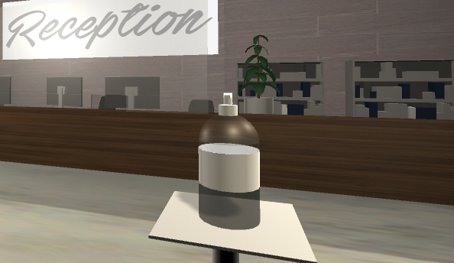
Hand sanitizer

Slide 10
3. Scenes/Locations

Slide 11
Locations
There are 4 locations in this game
All locations have to adhere to the coronavirus restrictions
Some locations have designated sanitizing stations

Slide 12
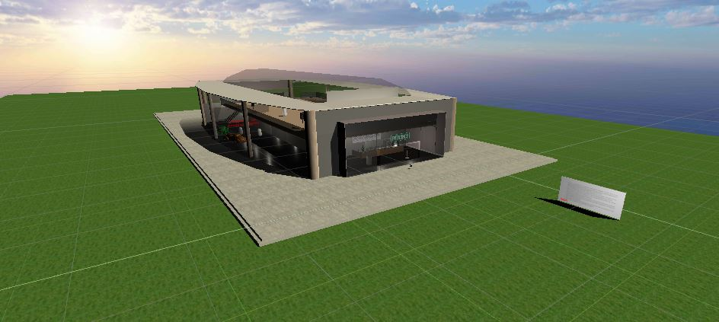
Environment

Slide 13
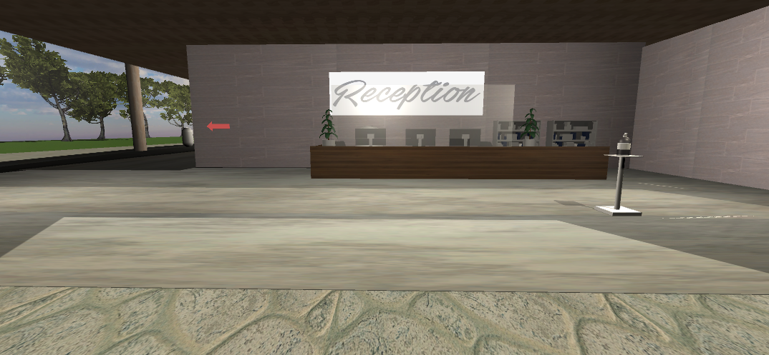
Reception

Slide 14
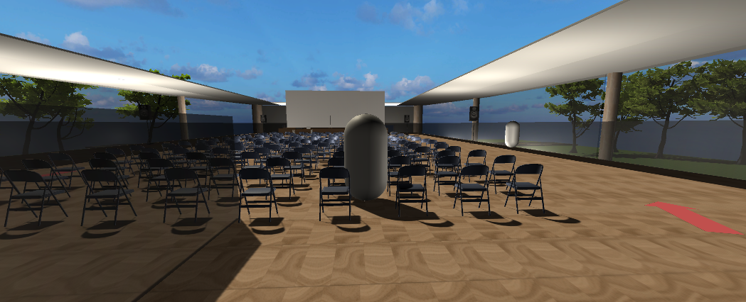
Presentation Hall

Slide 15
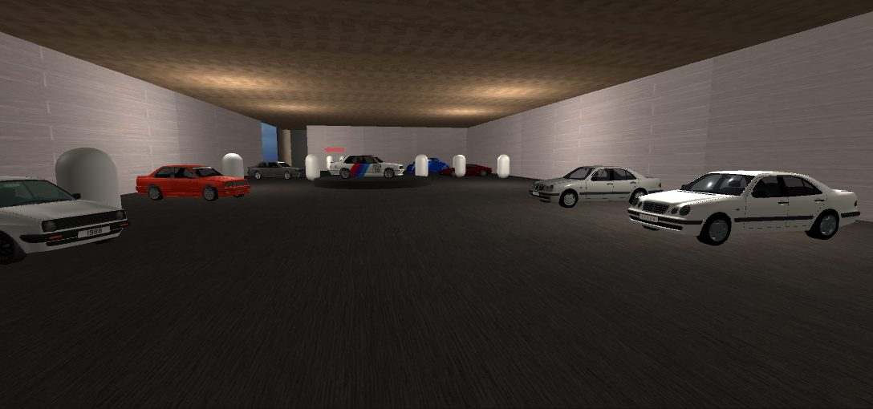
Car Showroom

Slide 16
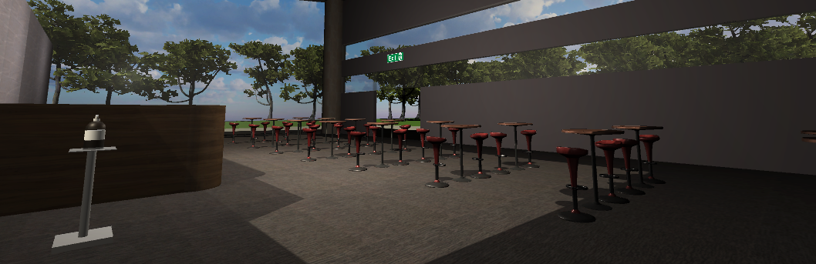
Bar

Slide 17
5.
Indicators

Slide 18
Indicators
Indicators give the user the present status of the game
In this game they are warning signs, health bars and arrows

Slide 19
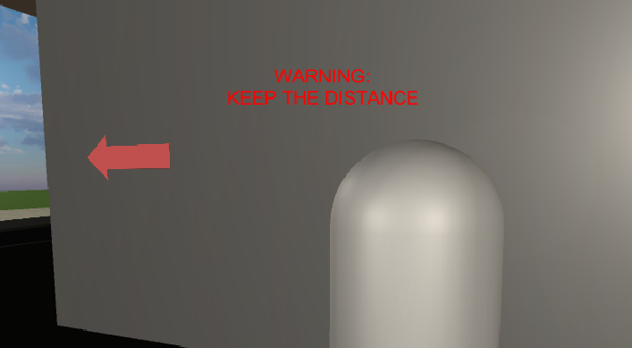
Warning message

Slide 20
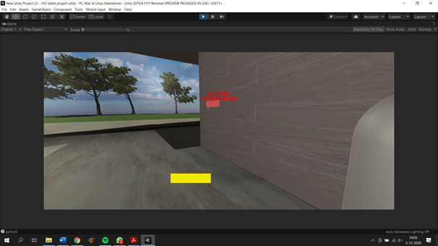
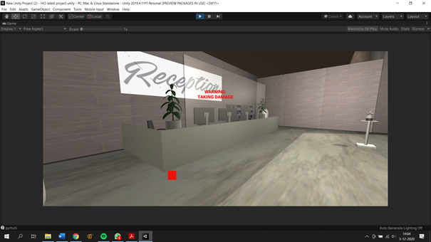
Health Bars

Slide 21
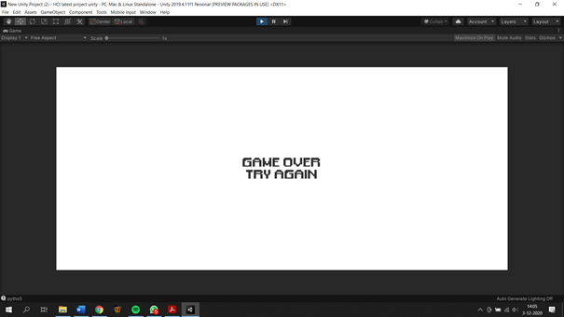
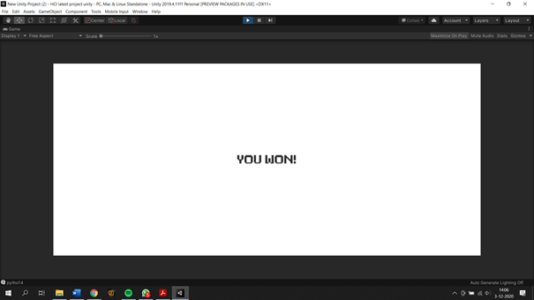
Game status

Slide 22
HCI principles
Match between system and real world
Consistency and standards
User control and freedom
Help and documentation
Make things visible
Offer informative feedback

Slide 23
Virtual Reality
Seamless and Comfortable experience
Use good HCI principles
Match sensory expectations

Slide 24

Avoiding Cybersickness
VR tunneling
Frequent and Adequate feedback
Keep movement steady
See through mall

Slide 25
Thank you for listening to our video presentation.
We hope you enjoy our game.

